Slide 1


Slide 2
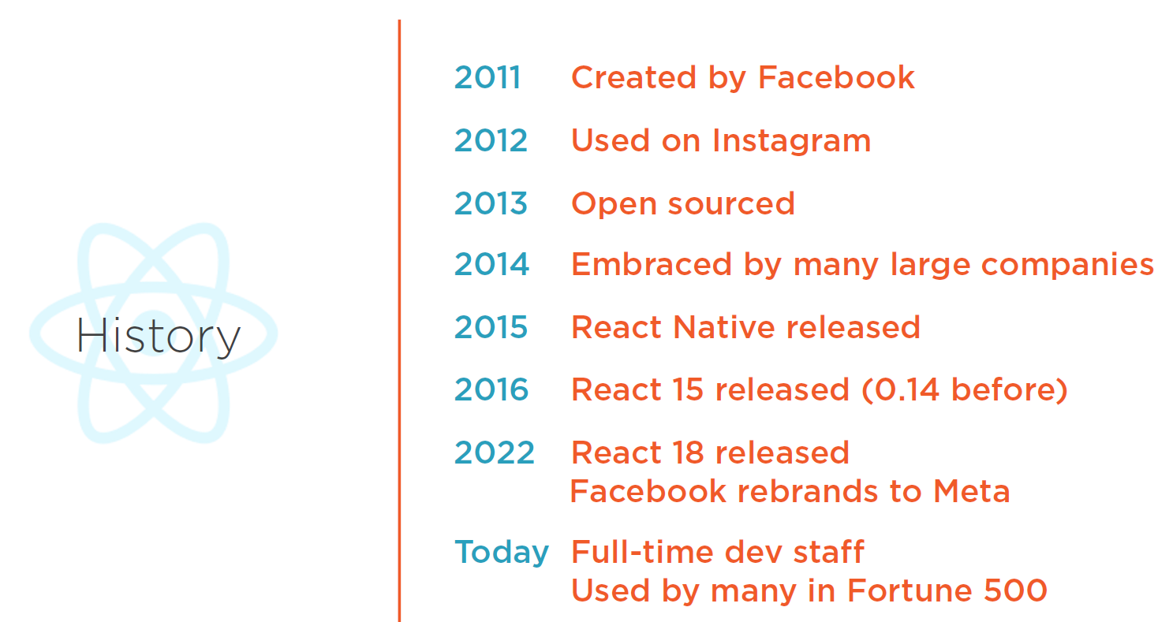

Slide 3


Slide 4
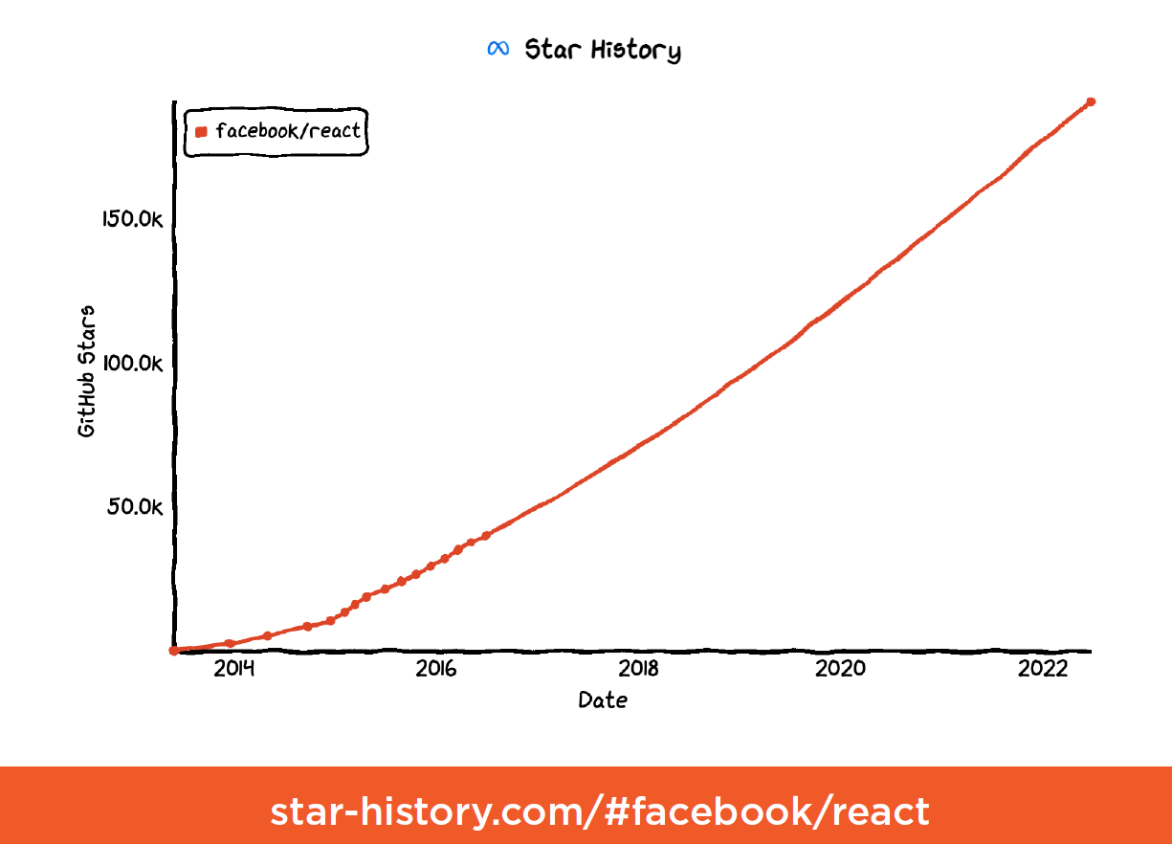
https://github.com/enaqx/awesome-react

Slide 5
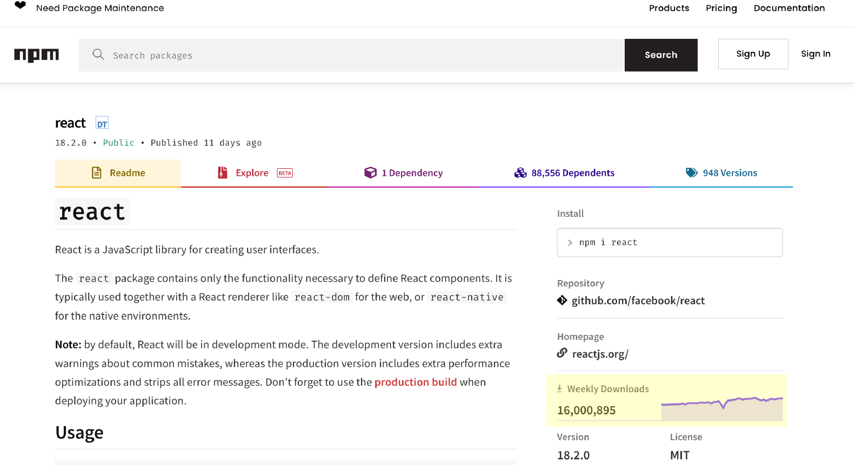

Slide 6


Slide 7


Slide 8


Slide 9


Slide 10

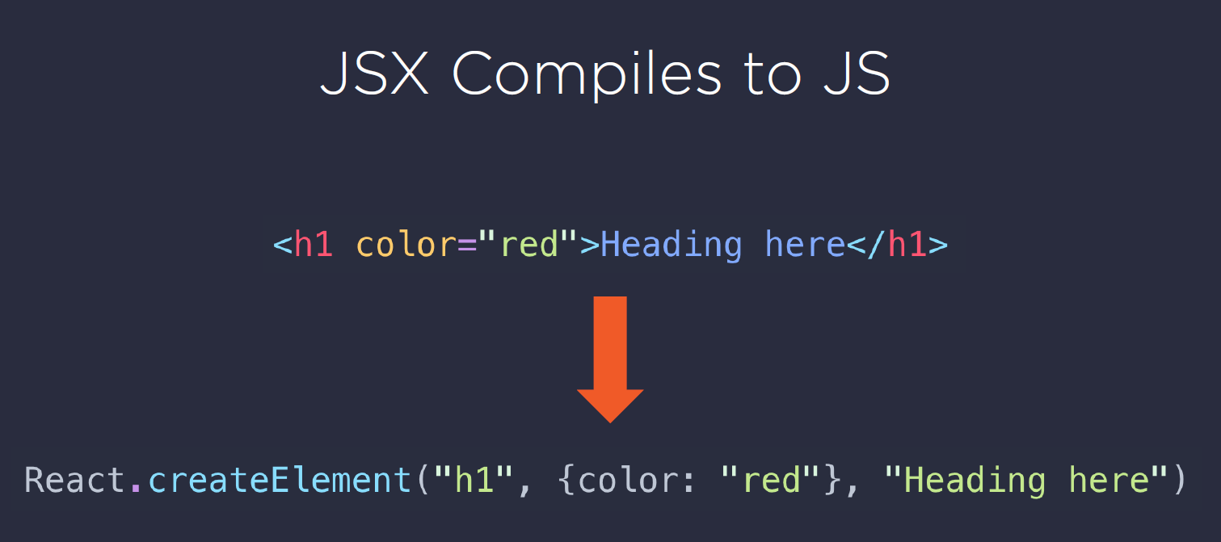
github.com/chentsulin/awesome-react-renderer

Slide 11


Slide 12
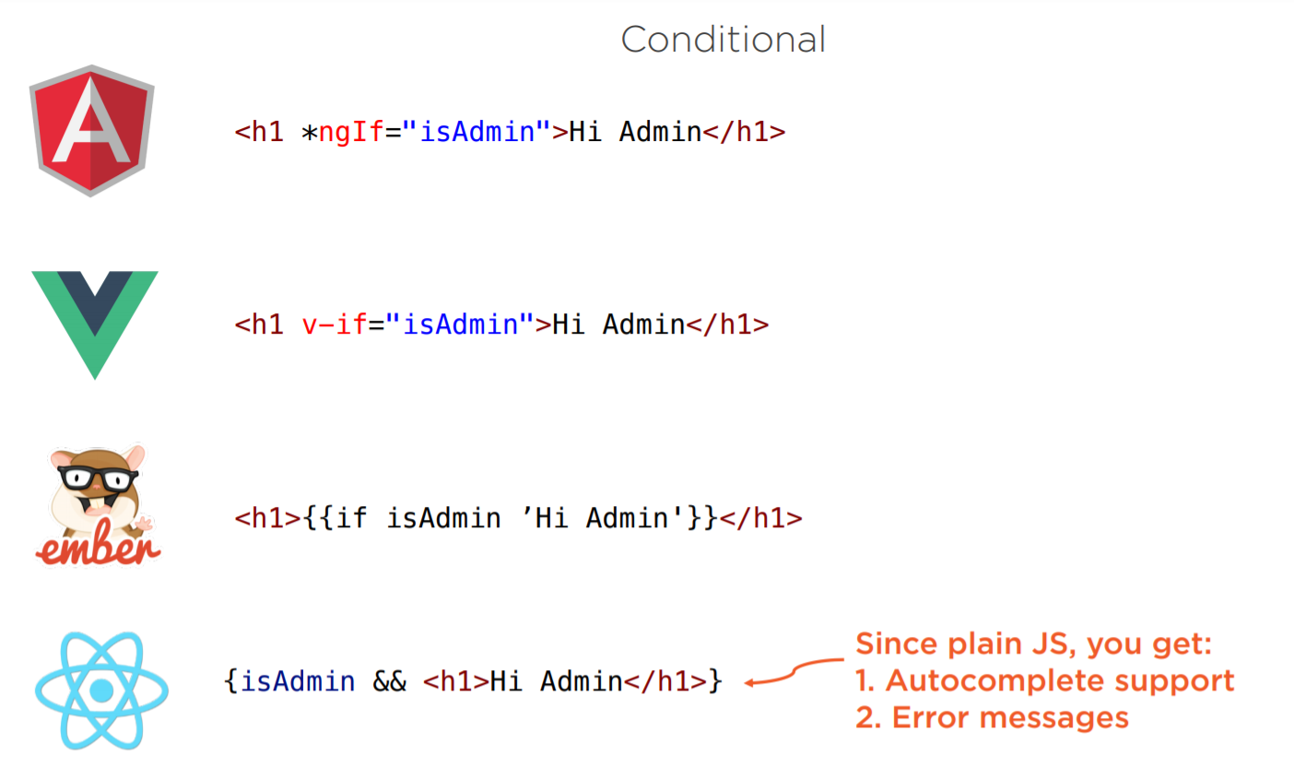

Slide 13
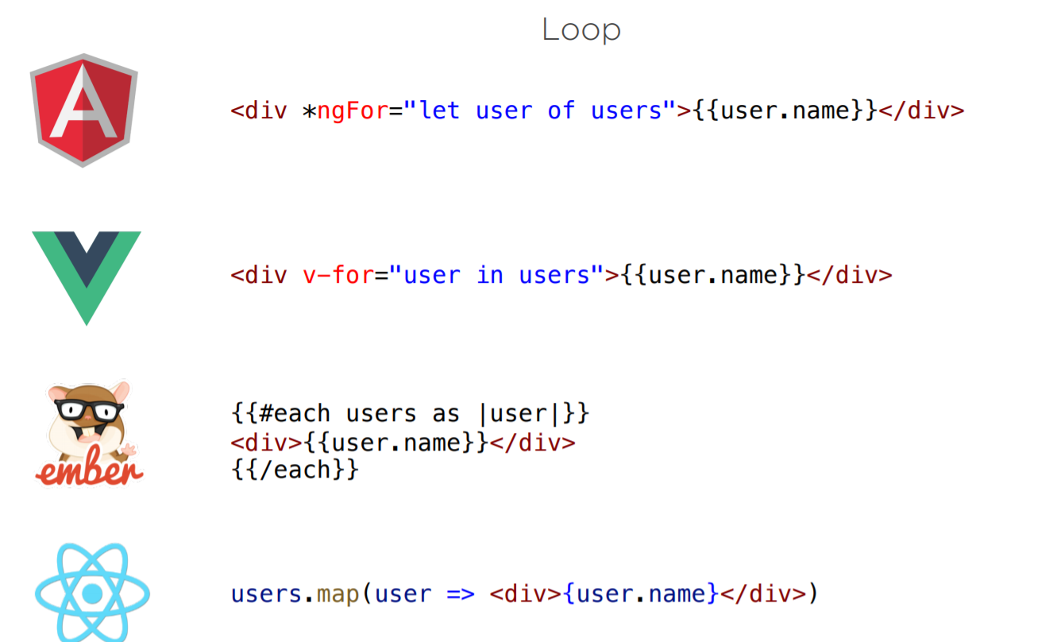

Slide 14
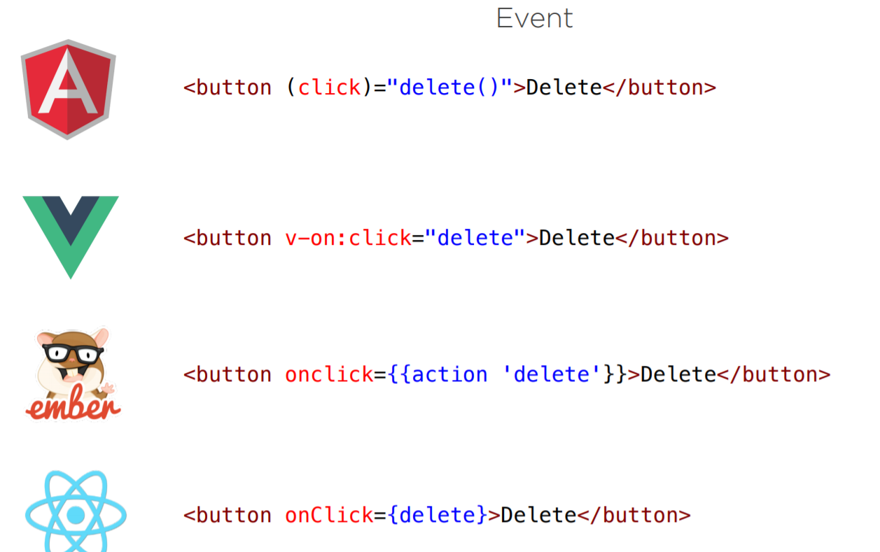

Slide 15


Slide 16
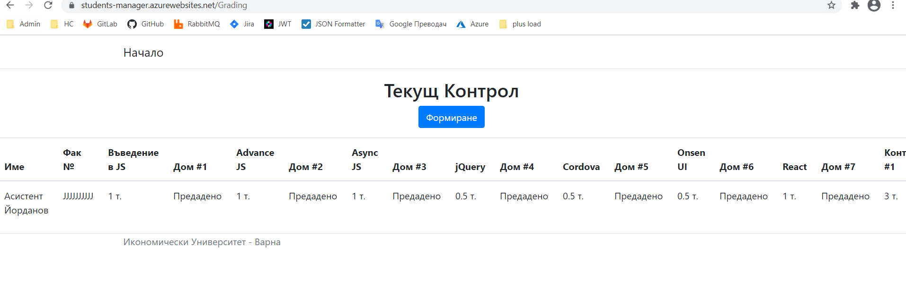
Replace Grading page with React

Slide 17

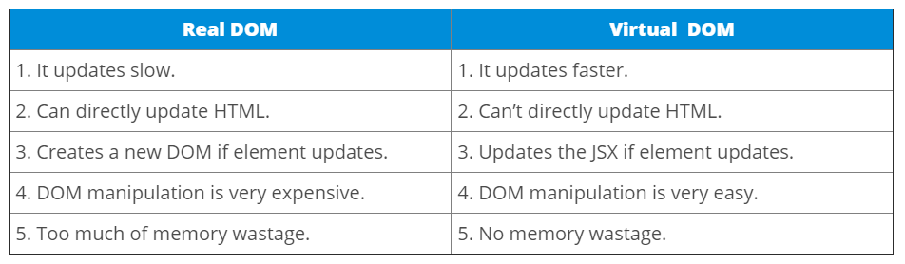

Slide 18
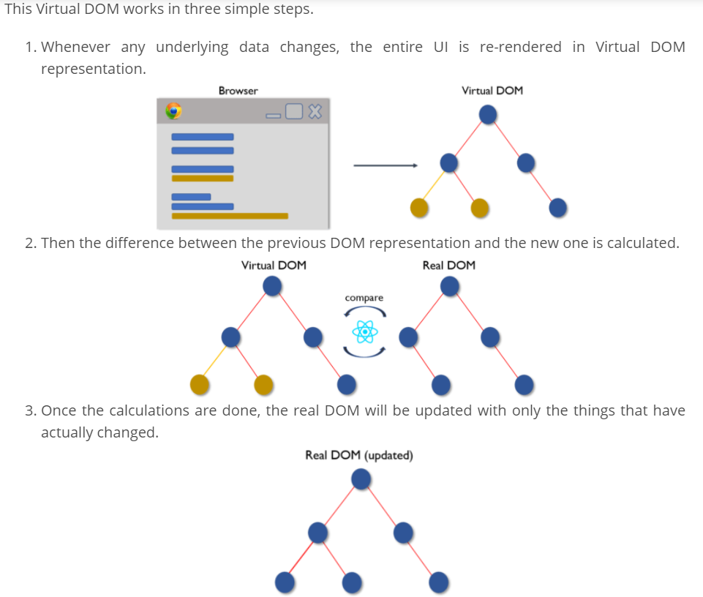

Slide 19
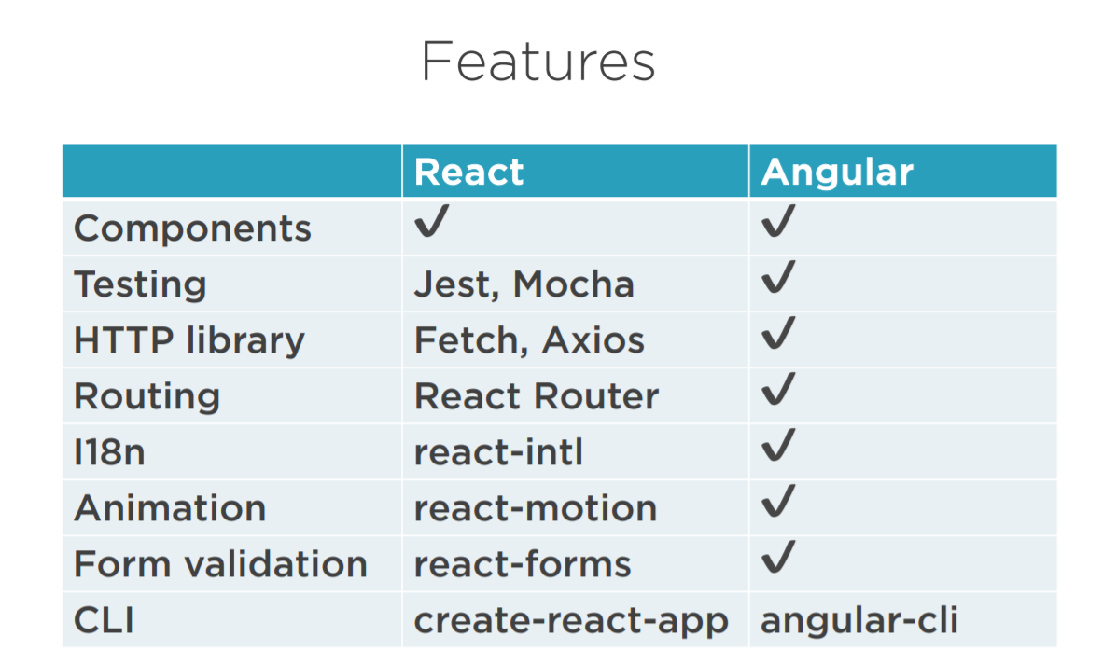

Slide 20
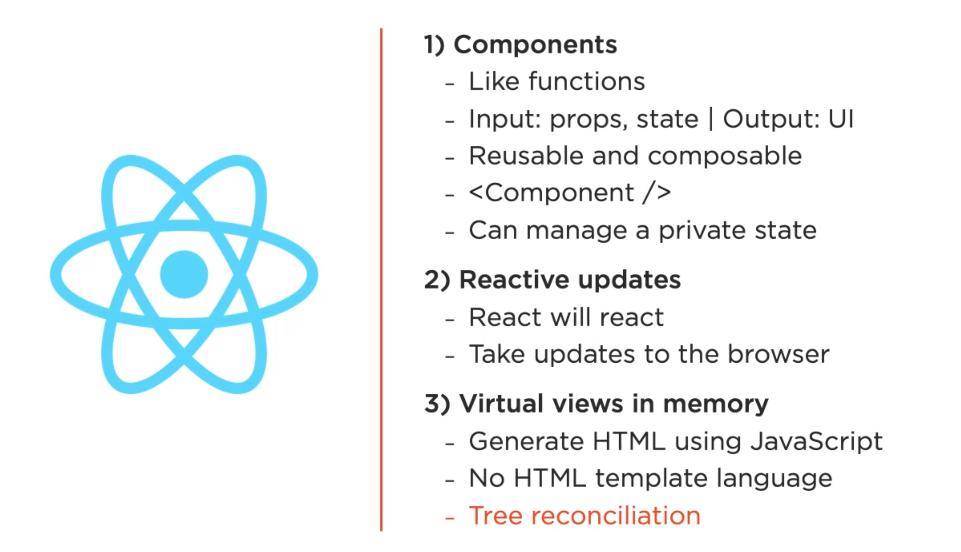
https://bg.reactjs.org/

Slide 21
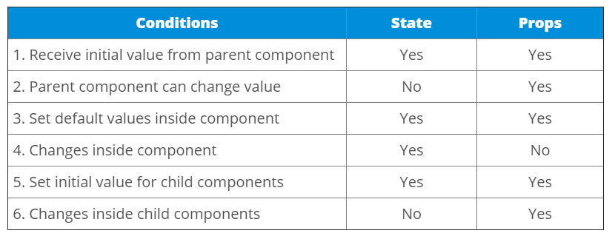
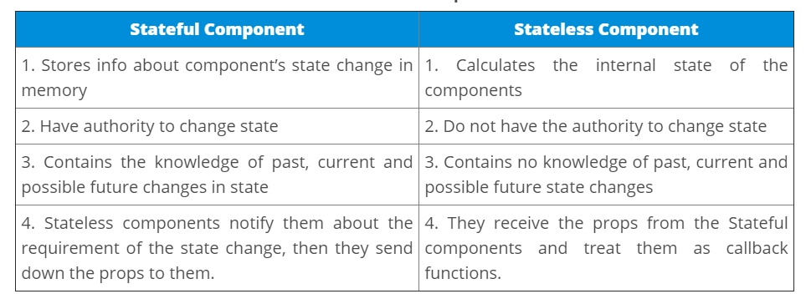

Slide 22
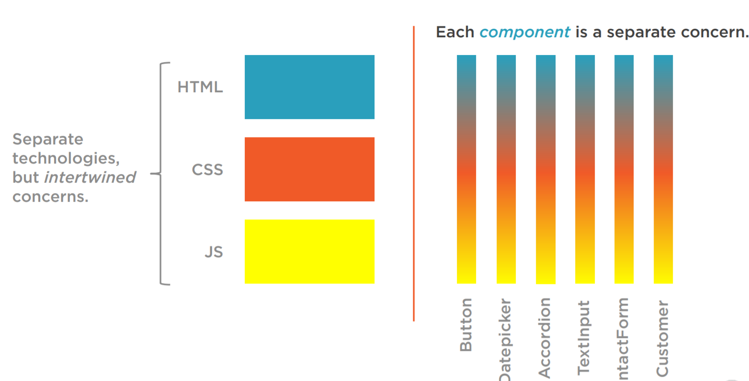
50,000

Slide 23
Playground
https://jscomplete.com/playground/scopes
https://jscomplete.com/playground/arrow-vs-regular-functions
https://jscomplete.com/playground/object-literals
https://jscomplete.com/playground/destructuring
https://jscomplete.com/playground/template-strings
https://jscomplete.com/playground/classes
https://jscomplete.com/playground/promises
https://jscomplete.com/playground/rgs1.1
https://jscomplete.com/playground/rgs1.2
https://jscomplete.com/playground/rgs1.4
https://jscomplete.com/playground/rgs1.3
https://jscomplete.com/playground/rgs1.5
https://jscomplete.com/playground/rgs1.6
https://jscomplete.com/playground/rgs1.8

Slide 24

codesandbox.io

